Slide 1

Department of Computer Science and Engineering
(Cyber Security)
WEB PROGRAMMING MINI PROJECT
PAWADOPT - A Web-Based Pet Adoption and Rescue Platform
NAME: NANDHINI VELMURUGAN
REG NO: 2116241901063

Slide 2
ABSTRACT
PawAdopt is a web-based pet adoption and rescue platform that connects caring families with verified rescue dogs, cats, birds and small companions. It gives adopters a single place to browse pets, search and filter by species, size and adoption status, and view health details such as vaccination, spay/neuter and microchip status. Shelters and individuals can list a pet through an online form. Pet locations are shown on an interactive map, colour-coded by status.
PawAdopt is built with HTML5, CSS3, JavaScript and Leaflet.js. It demonstrates responsive design, DOM manipulation, event handling, form validation and third-party map integration in a practical web application.

Slide 3
PROBLEM STATEMENT
Existing Problem
Pet adoption information is scattered across social media posts, word of mouth and outdated shelter websites, which makes finding and trusting a pet listing difficult.
Common challenges include:
No single place to browse adoptable pets.
Difficulty searching by breed, size, species or personality.
Unclear health and vaccination information.
Hard to know whether a pet is still available, pending or already adopted.
No easy way to see where a pet is located.
No simple way for shelters to list animals online.
Proposed Solution
PawAdopt provides a centralized, easy-to-use web platform where adopters can discover verified rescue pets and shelters can list them for adoption.

Slide 4
PROJECT OBJECTIVES
Develop an interactive and user-friendly pet adoption website.
Implement responsive web pages with a modern dark-themed interface.
Provide keyword search plus size, status and species filters.
Display verified medical details (vaccinated, spayed/neutered, microchipped).
Show pet status as Ready to Adopt, Pending or Adopted.
Integrate an interactive map of shelter and foster locations.
Create a List a Pet form with validation and photo upload.
Test the functionality and usability of the application.

Slide 5
TOOLS AND TECHNOLOGIES
CATEGORY | TECHNOLOGY | PURPOSE
Frontend | HTML5, CSS3, JavaScript | Page structure, styling and interactivity
Styling | CSS Flexbox, Grid, gradients | Responsive layout and dark UI
Map Library | Leaflet.js | Interactive shelter map
Map Data | OpenStreetMap | Map tiles
Fonts and Icons | Google Fonts, SVG icons, emojis | Typography and visuals
Data Handling | JavaScript objects / localStorage | Storing pet records
Development Environment | VS Code | Coding and debugging
Browser Tools | Chrome DevTools | Testing and debugging
Version Control | Git / GitHub | Tracking code changes

Slide 6
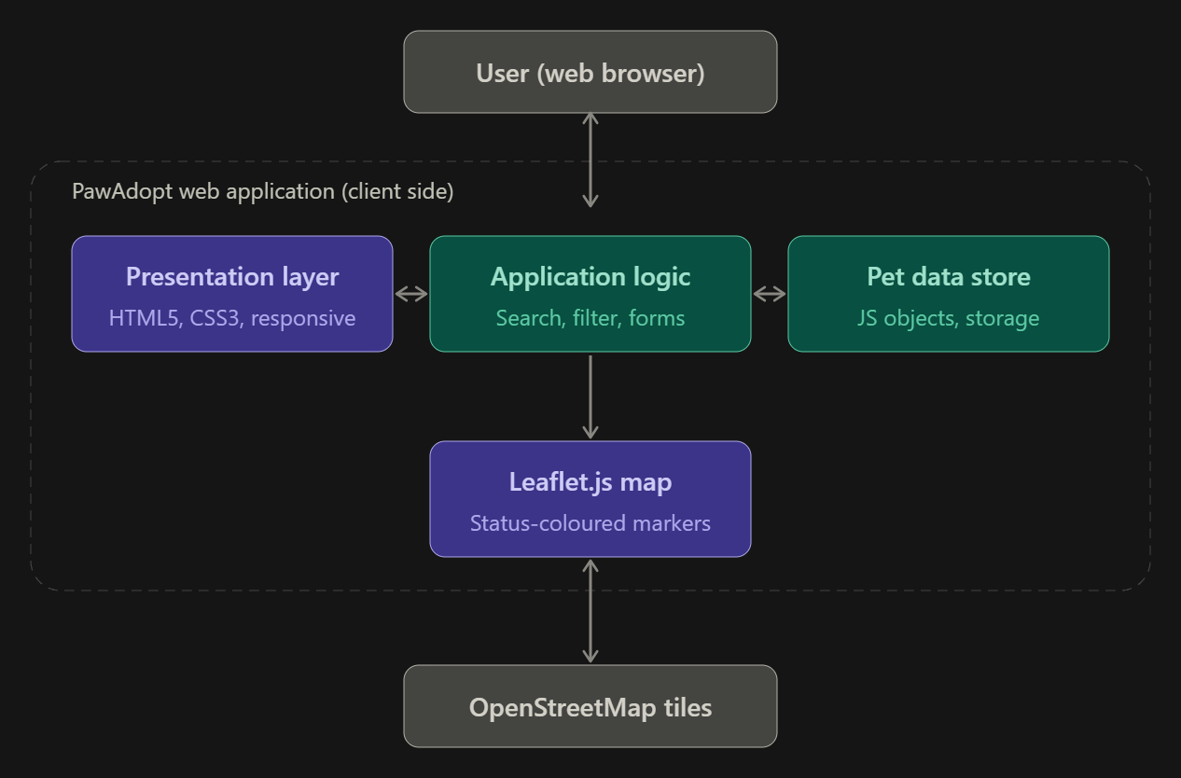
SYSTEM ARCHITECTURE

Slide 7
WEBSITE MODULES
1. Home / Hero Module
Shows the tagline, navigation bar and call-to-action buttons.
Shows live stats: Ready for Adoption, Pending Inquiries, Happily Adopted and 100% Health Vetted.
2. Pet Listing Module
Displays pets as cards with photo, status, fee, age, gender and breed.
Shows health tags and personality traits.
3. Search and Filter Module
Keyword search by breed, personality or “good with kids”.
Filters by size, status and species, with sorting such as Recently Added.

Slide 8
WEBSITE MODULES
4. Shelter Map Module
Displays rescue shelters and foster locations with Leaflet.
Uses colour-coded markers: Available, Application Pending, Adopted.
5. List a Pet Module
Let's shelters add a pet through a validated form.
Collects medical verification, personality traits, rescue story and photo.
6. Why Adopt Module
Presents the PawAdopt Promise: Medical Vetted, 2-Week Trial Foster, Direct Foster Chat and Lifetime Support.

Slide 9
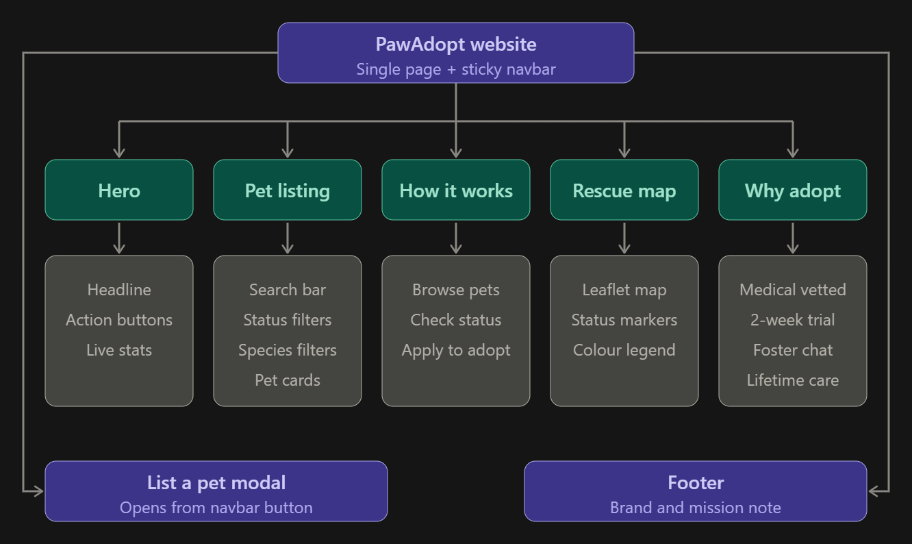
WEBSITE WORKFLOW

Slide 10
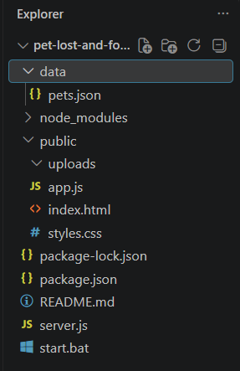
PROJECT STRUCTURE & FILE ORGANIZATION

Slide 11
IMPLEMENTATION
Home page: The hero section shows the tagline “Find Your Forever Companion” with Browse and List a Pet buttons, plus live stats: Ready for Adoption, Pending Inquiries, Happily Adopted and 100% Health Vetted.
Search and filters:
  Keyword search by breed, personality or “good with kids”.
  Size dropdown and sort options such as Recently Added.
  Status tabs: All, Ready to Adopt, Pending and Adopted.
  Species filters: Dogs, Cats, Birds and Others.
Pet cards: Each card shows the photo, status badge, adoption fee, species, age, gender, breed, health tags and personality traits.
Shelter map: Leaflet displays colour-coded markers: purple for Available, orange for Application Pending and green for Adopted.
List a Pet form:
  Fields for breed, gender, age, size, fee and shelter location.
  Health verification checkboxes and personality traits.
  A rescue story and a photo upload.
Why Adopt section: It highlights four promises: 100% Medical Vetted, 2-Week Trial Foster, Direct Foster Chat and Lifetime Support.

Slide 12
TESTING AND RESULTS
Tested search by breed and keyword.
Verified size, status and species filters and sorting.
Checked that the status counts (All 7, Ready 5, Pending 1, Adopted 1) update correctly.
Tested switching between Cards and Shelter Map views.
Verified the map markers and colour coding.
Tested the List a Pet form validation and photo upload.
Checked responsiveness on desktop and mobile screen sizes.

Slide 13
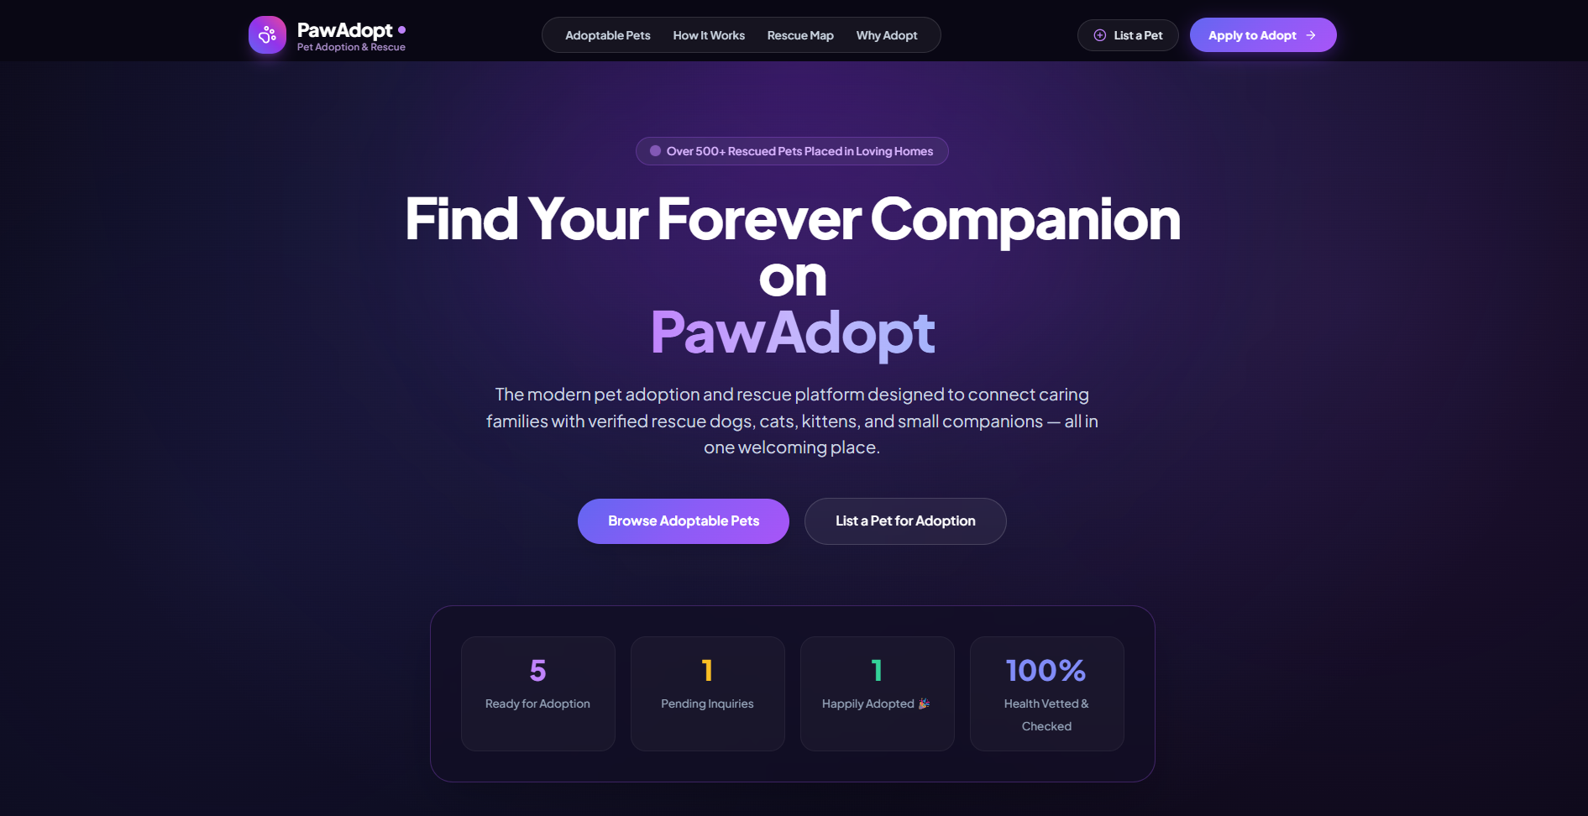
PROTOTYPE

Slide 14
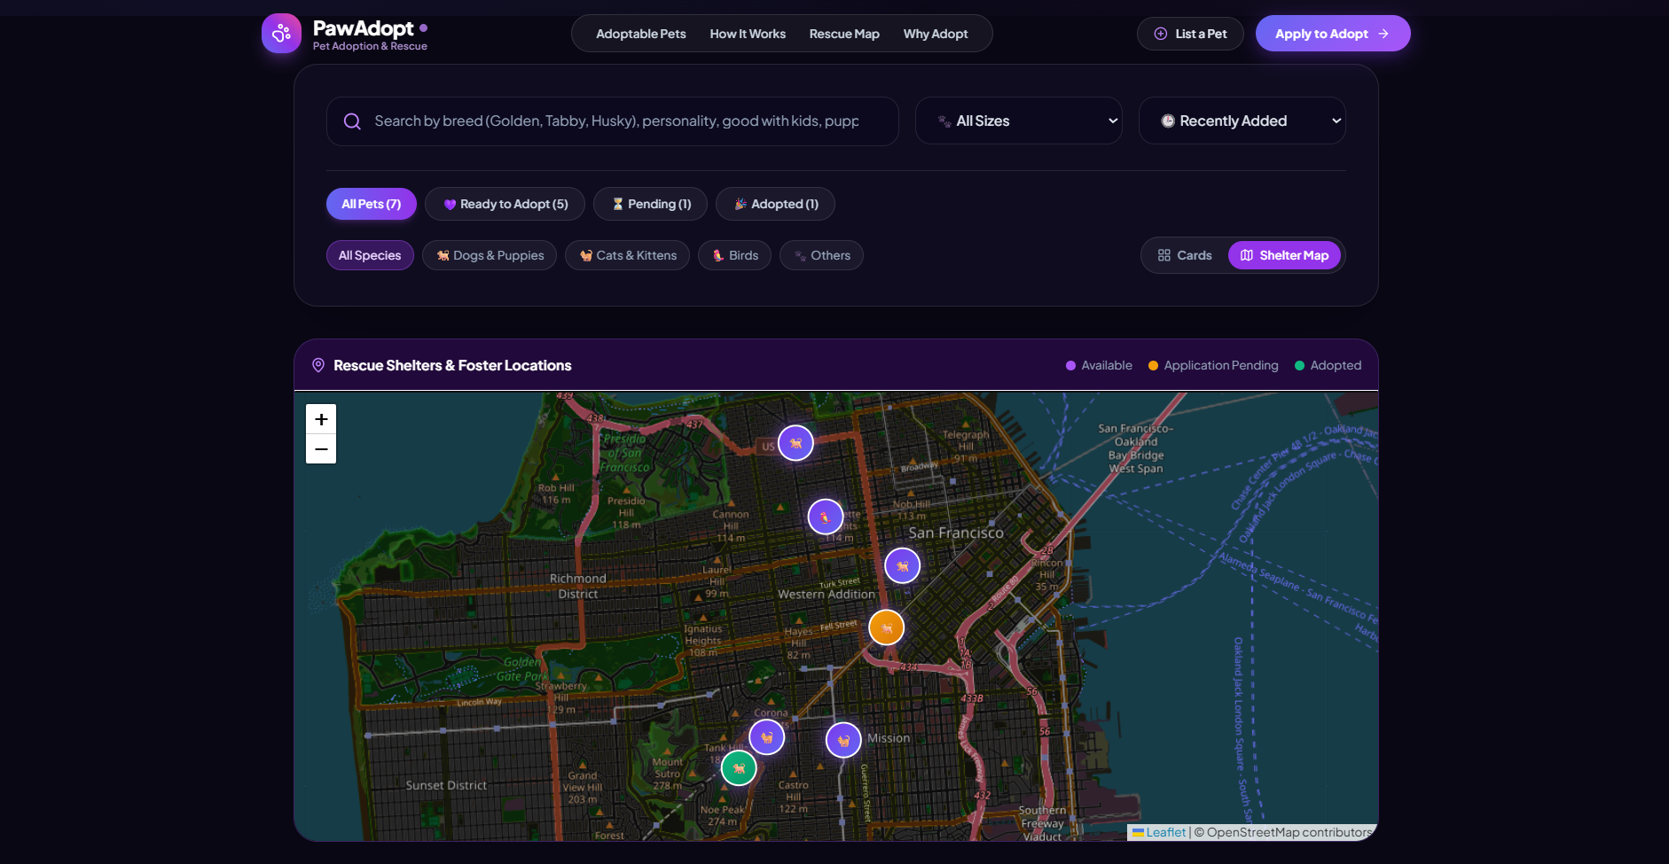
PROTOTYPE

Slide 15
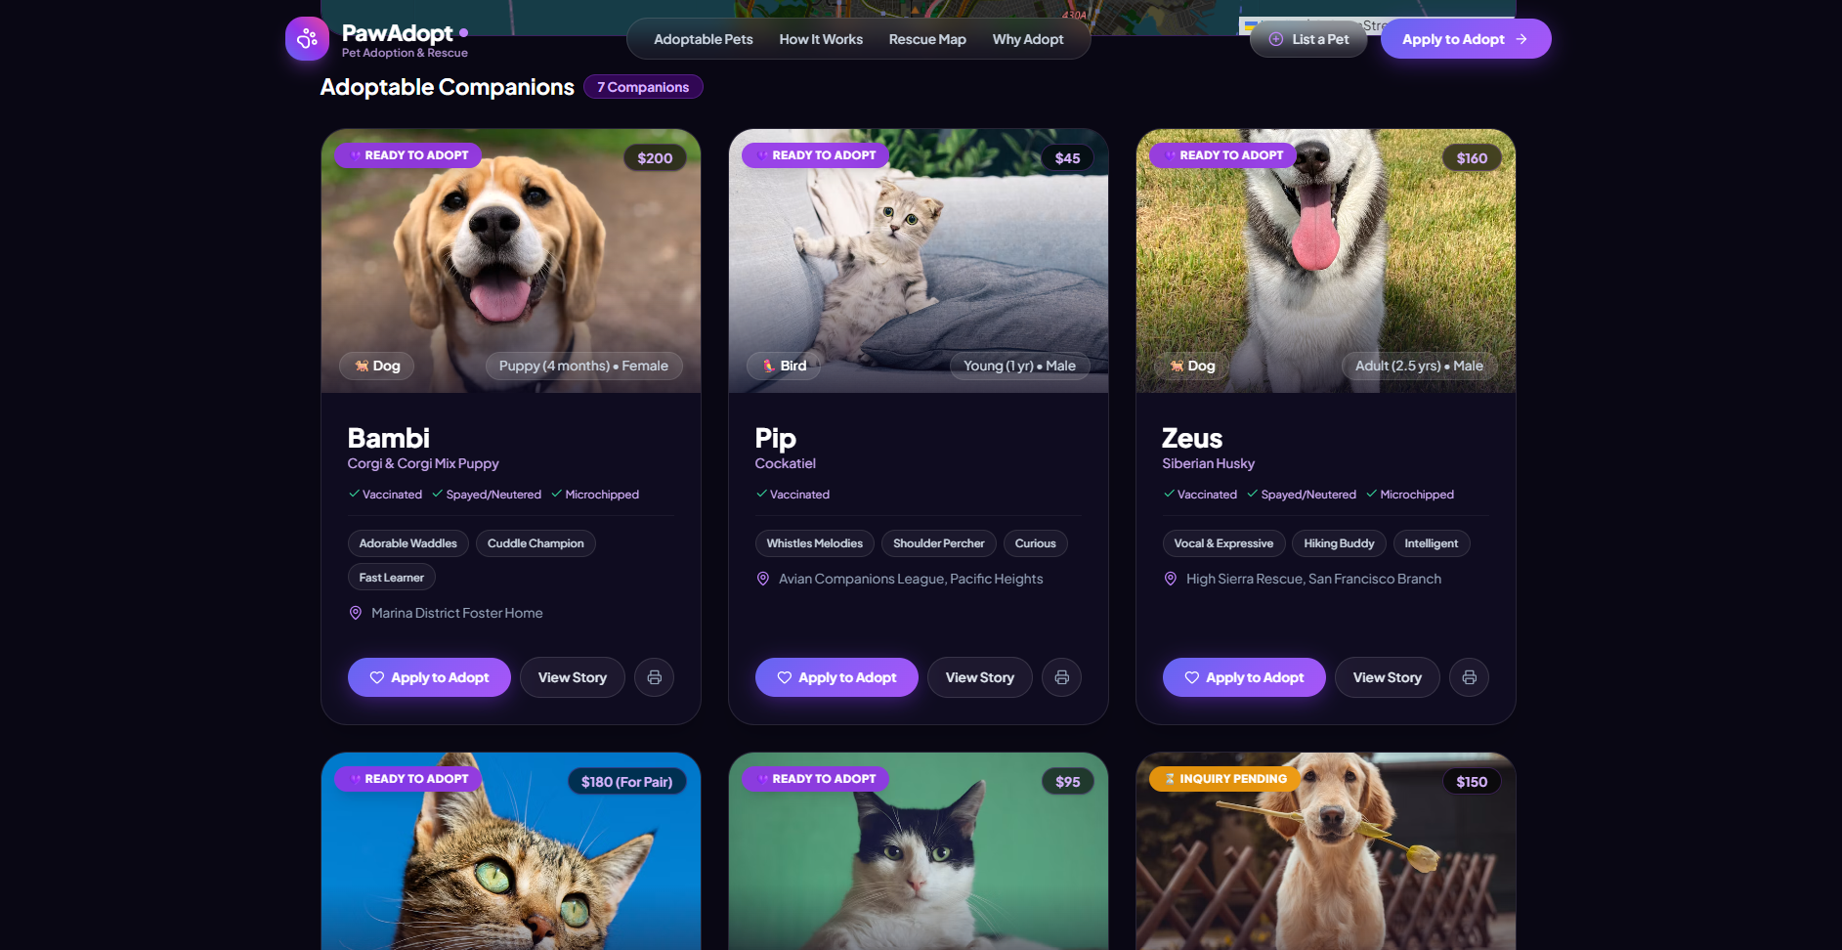
PROTOTYPE

Slide 16
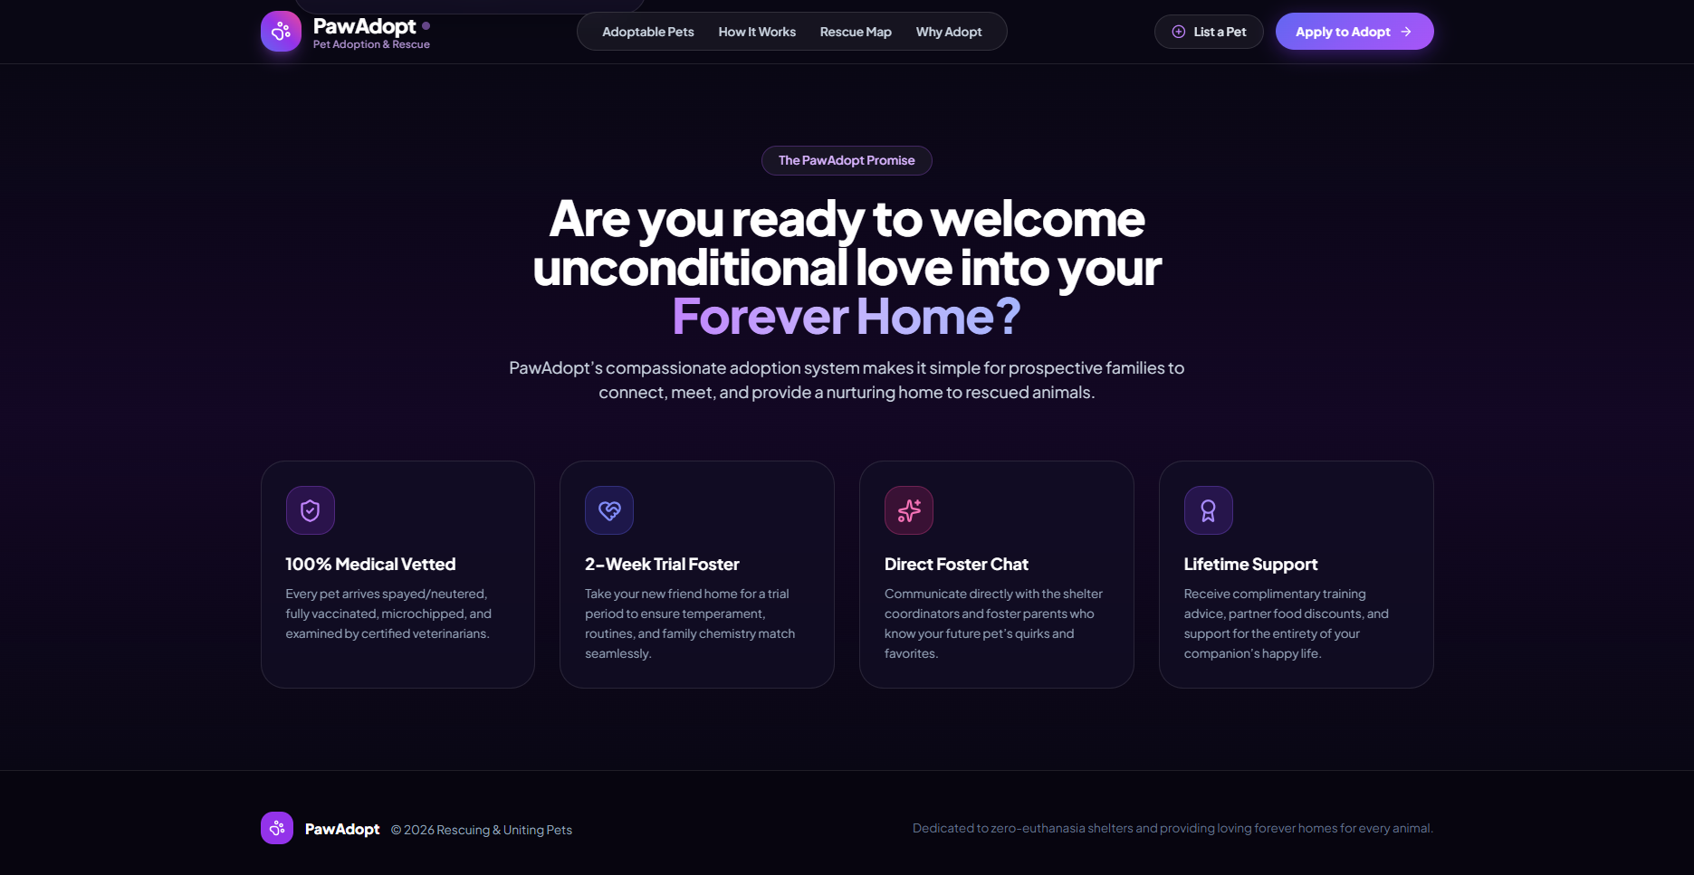
PROTOTYPE

Slide 17
CONCLUSION
PawAdopt is a web-based pet adoption platform designed to simplify finding and listing rescue animals. It provides pet browsing, search and filtering, verified health information, interactive map locations and an online listing form. The system uses HTML, CSS and JavaScript with Leaflet.js for mapping. It helps shelters reach adopters, makes adoption information transparent and encourages responsible adoption.

Slide 18
FUTURE ENHANCEMENTS
Add user login for adopters and shelters.
Add a backend and database (Node.js or PHP with MySQL/MongoDB) for permanent storage.
Add online adoption applications with admin approval.
Add real-time chat between adopters and foster coordinators.
Send email or SMS notifications on application status changes.
Add a “pets near me” feature using the Haversine formula and GPS.
Develop a mobile application.

Slide 19
REFERENCES
[1] Jagtap, Y. D. (2025). Shelter Soul: Bridging shelters and adopters through technology. arXiv:2506.12739.
[2] Nauli, S. B., Kusumawati, K., Sitorus, H., Chafid, N., Panjaitan, B., & Rahmatina, I. Web-based application design for adoption of abandoned pets. Format journal, Universitas Mercu Buana.
[3] Development of a proximity-based pet adoption website application (2025). IJSECS.
[4] Leaflet. (n.d.). Leaflet documentation. https://leafletjs.com/
[5] OpenStreetMap contributors. https://www.openstreetmap.org/
[6] MDN Web Docs. HTML, CSS and JavaScript. https://developer.mozilla.org/

